Slide 1

SPARK AIRWAYS
GOOD THINGS COME TO THOSE WHO FLY
Abhay Raj Singh
Anshuman Sahu
Bhavesh Saini
Nikhil Kharwal
Siddharth Sharma

Slide 2

WHY SPARK AIRWAYS ?
The purpose of the Spark Airways is to allow customer to interact that gives some basic information such as all flights information, availability of accommodation in flights, ticket booking.
SPARK AIRWAYS

Slide 3
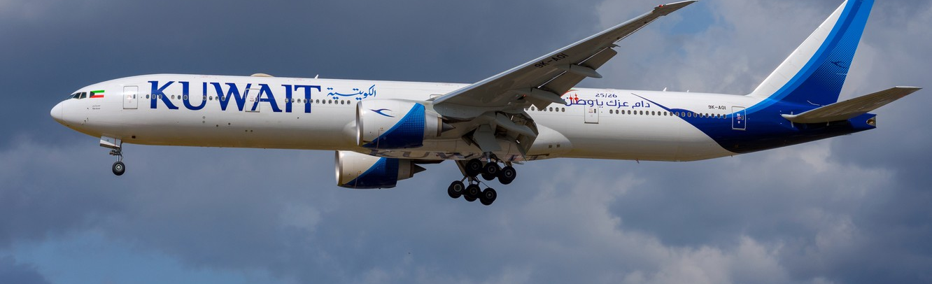
ACTORS
Admin
User
SPARK AIRWAYS

Slide 4

ADMIN
Add Flight
Update Flight
Delete Flight
Admin Login/Logout
Add News
Update News
Delete News
SPARK AIRWAYS

Slide 5



USER
User Registration/Login
Flight Information
Flight Booking
Cancel Booking
Ticket Payment
View Tickets
SPARK AIRWAYS

Slide 6
ER DIAGRAM
EXPECTED ER DIAGRAM FOR SPARK AIRWAYS

Slide 7
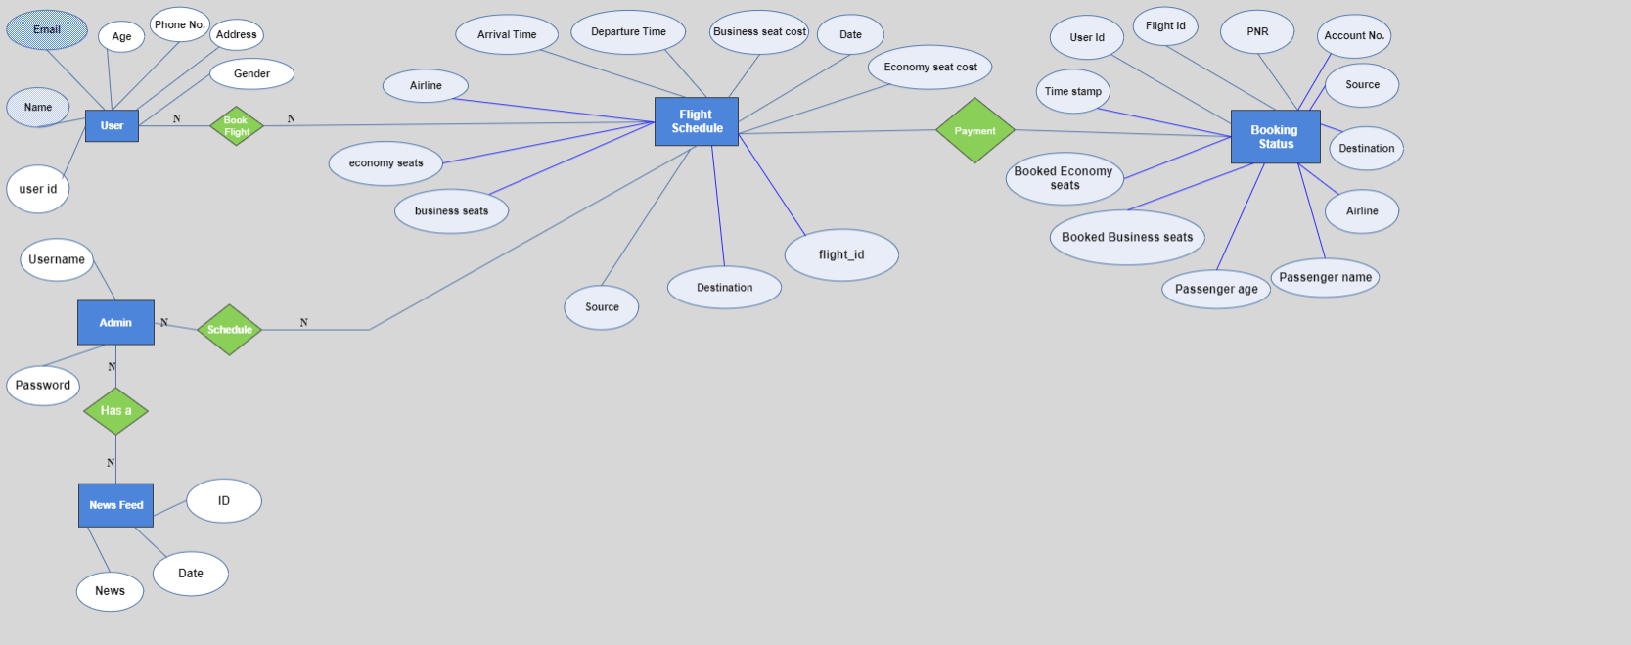

Slide 8
DATA FLOW DIAGRAM
EXPECTED DATA FLOW DIAGRAM FOR SPARK AIRWAYS

Slide 9
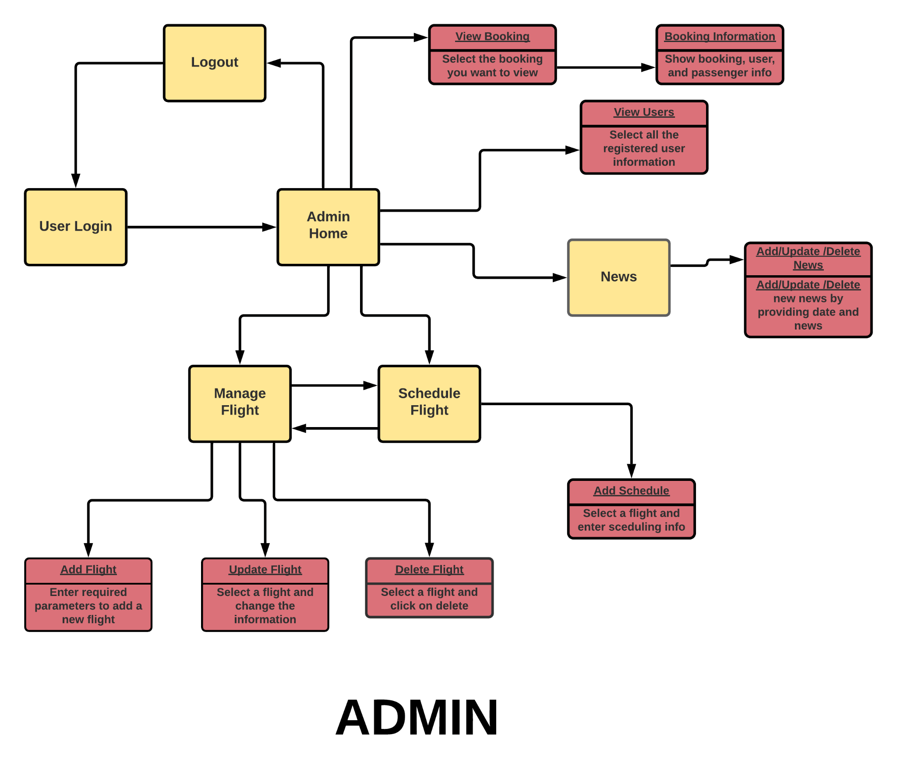
LINK

Slide 10
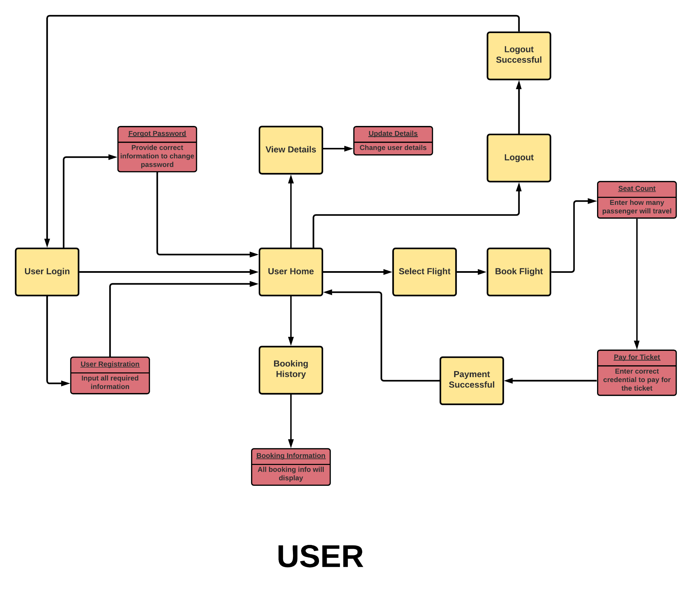
LINK

Slide 11
CLASS DIAGRAM
EXPECTED CLASS DIAGRAM FOR SPARK AIRWAYS

Slide 12
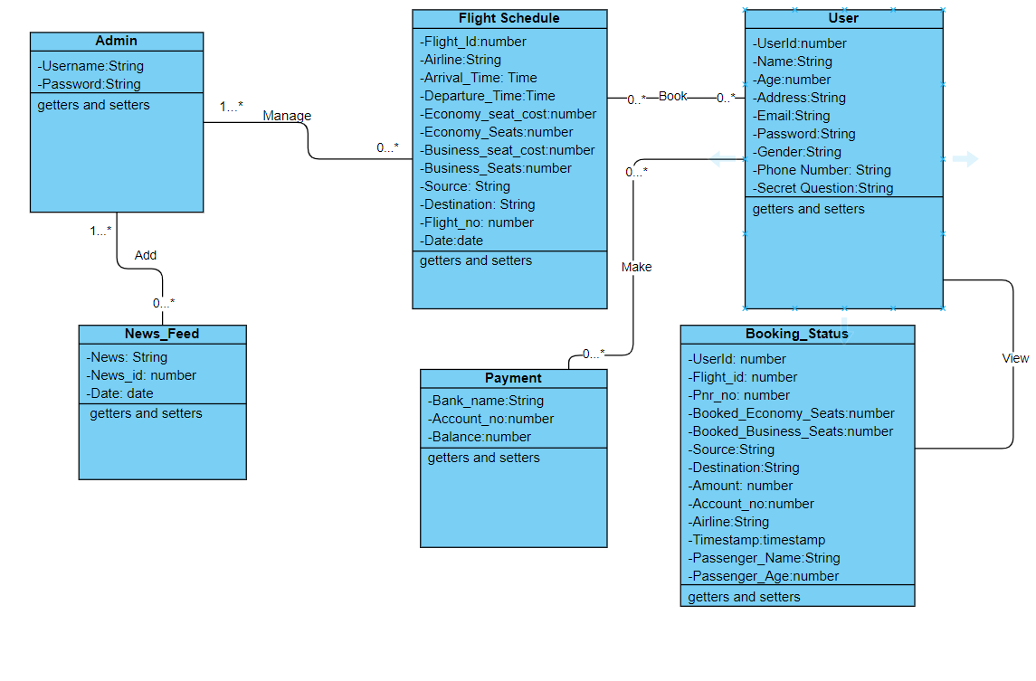

Slide 13
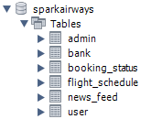
DATABASE SCHEMA
1. Admin
2. Bank
3. Booking Status
4. Flight Schedule
5. News Feed
6. User

Slide 14

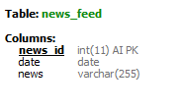
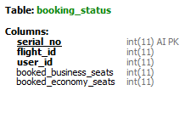
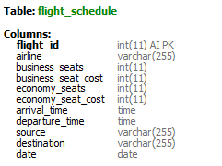
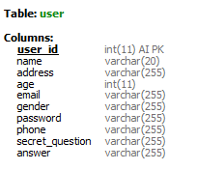


Slide 15
USE CASE DIAGRAM
EXPECTED USE CASE FLOW DIAGRAM FOR SPARK AIRWAYS

Slide 16
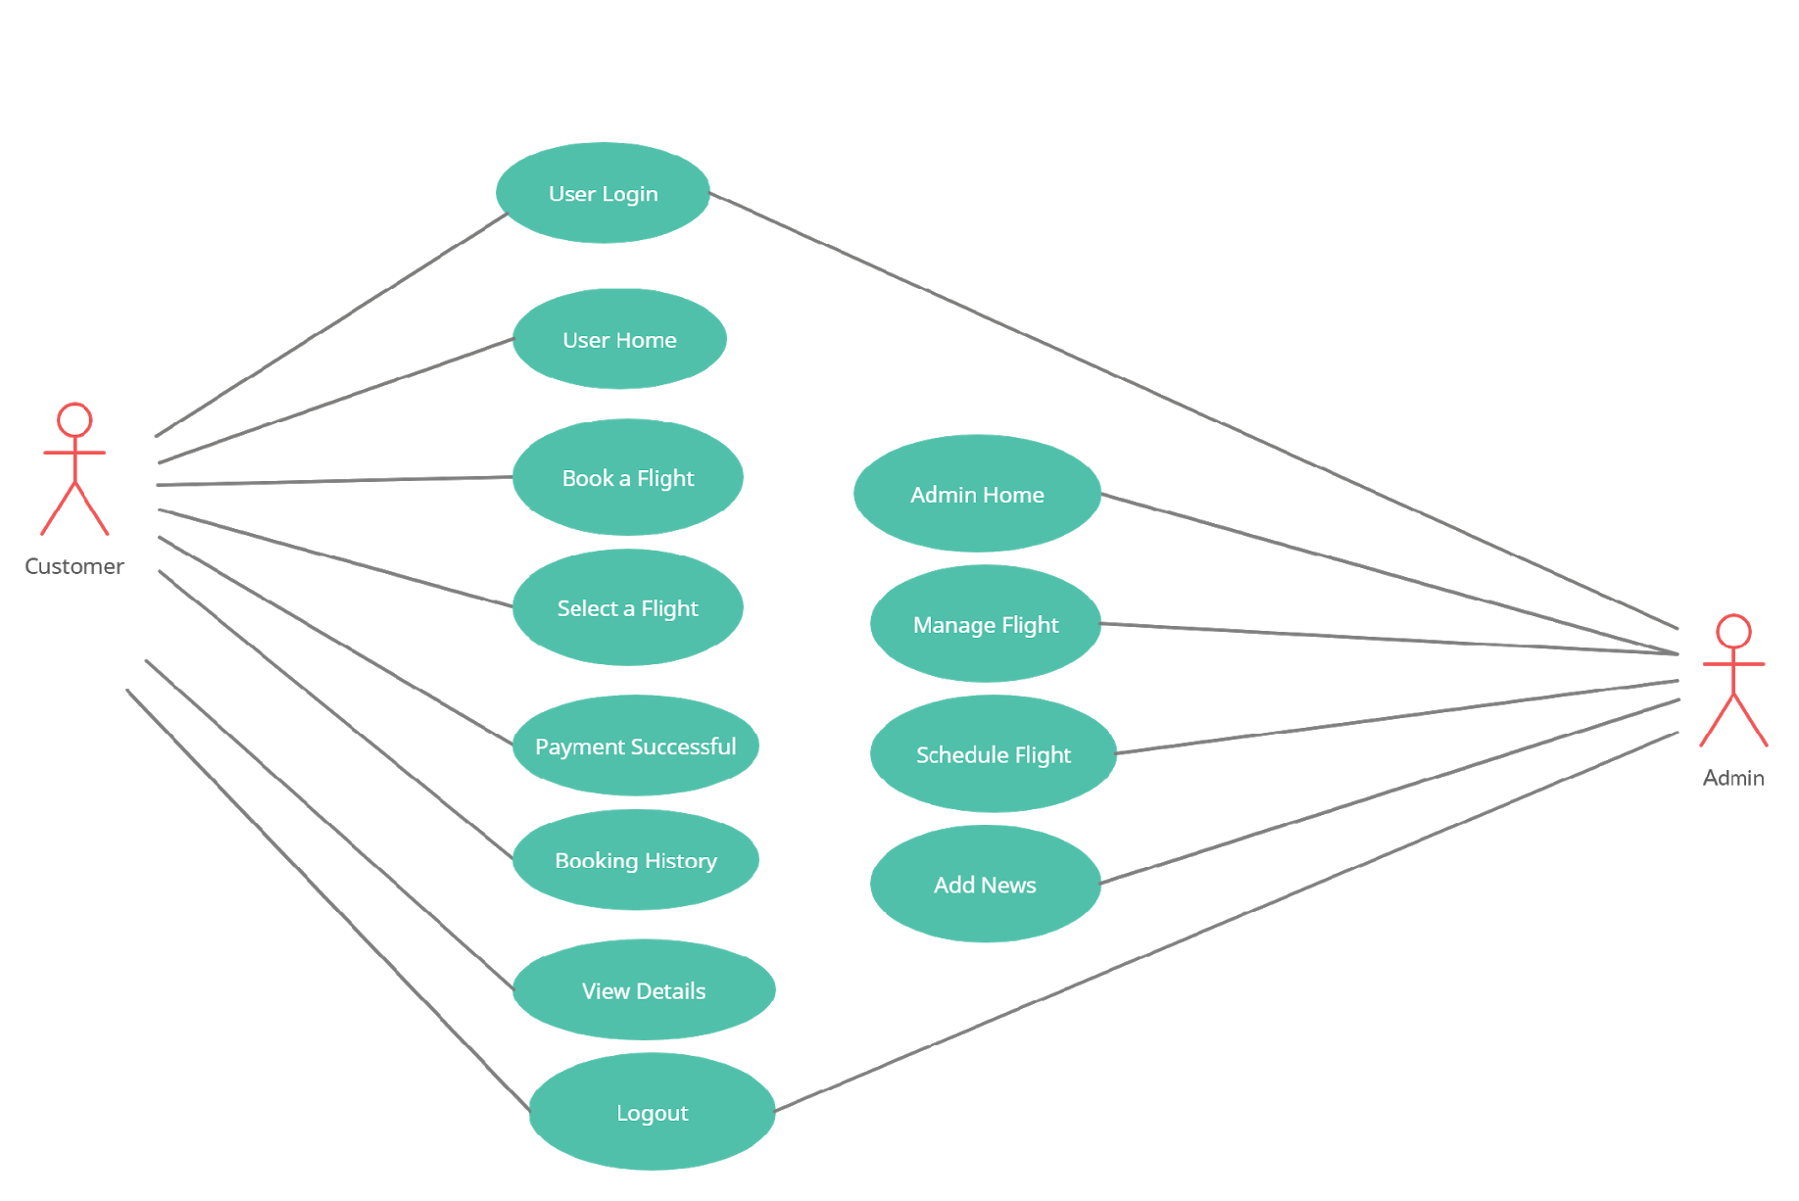

Slide 17
SERVICE DIAGRAM
EXPECTED SERVICE DIAGRAM FOR SPARK AIRWAYS

Slide 18
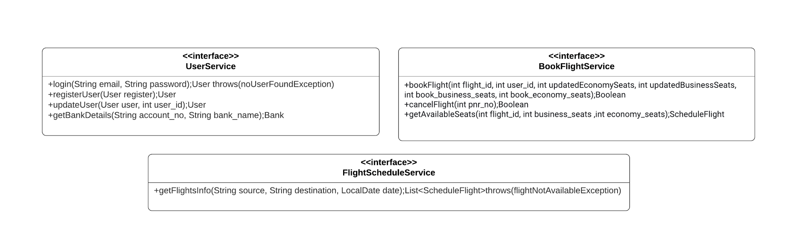
USER

Slide 19
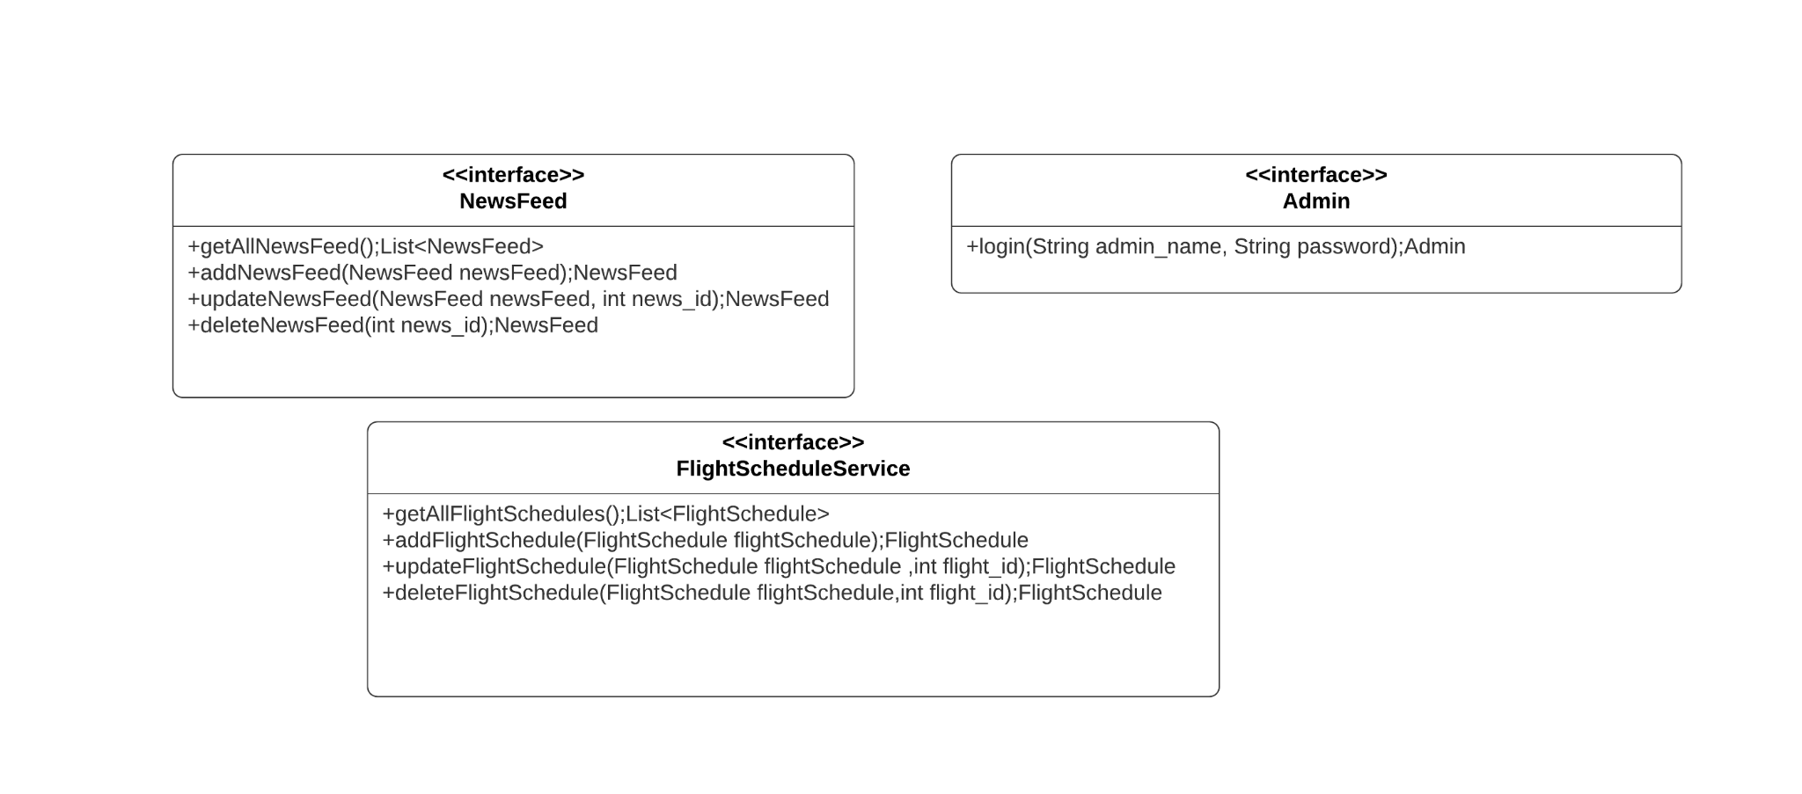
ADMIN

Slide 20
THANK YOU

